Slide 1


Bayan Zomarah
9/26/2023

Slide 2

Outline
Executive Summary
Introduction
Methodology
Results
Conclusion
Appendix

Slide 3
Executive Summary
In this capstone project, we will predict if the SpaceX Falcon 9 first stage will land successfully using several machine learning classification algorithm
Summary of methodologies
• Data Collection via API, Web Scraping
• Exploratory Data Analysis (EDA) with Data Visualization
• EDA with SQL
• Interactive Map with Folium
• Dashboards with Plotly Dash
• Predictive Analysis
Summary of all results
• Exploratory Data Analysis results
• Interactive maps and dashboard
• Predictive results : decision tree may be the best machine learning algorithm to predict if the Falcon 9 first stage will land successfully.

Slide 4
Introduction
Project background and context
The aim of this project is to predict if the Falcon 9 first stage will successfully land. SpaceX says
on its website that the Falcon 9 rocket launch cost 62 million dollars. Other providers cost upward
of 165 million dollars each. The price difference is explained by the fact that SpaceX can reuse the
first stage. By determining if the stage will land, we can determine the cost of a launch. This
information is interesting for another company if it wants to compete with SpaceX for a rocket
launch
Problems you want to find answers
What are the main characteristics of a successful or failed landing ?
What are the effects of each relationship of the rocket variables on the success or failure of a
landing ?
What are the conditions which will allow SpaceX to achieve the best landing success rate ?

Slide 5

Section 1

Slide 6
Methodology
Executive Summary
Data collection methodology:
SpaceX REST API
Web Scrapping from Wikipedia
Perform data wrangling
Dropping unnecessary columns
One Hot Encoding for classification models
Perform exploratory data analysis (EDA) using visualization and SQL
Perform interactive visual analytics using Folium and Plotly Dash
Perform predictive analysis using classification models
How to build, tune, evaluate classification models

Slide 7
Data Collection
SpaceX REST API
Web Scrapping from Wikipedia
Calling SpaceX API
JSON Response
To Dataframe
Clean and Export Data to CSV
Get HTML Response from Wikipedia
Extract data with BeautifulSoup
To Dataframe
Clean and Export Data to CSV

Slide 8
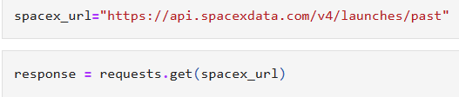
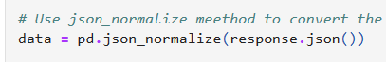
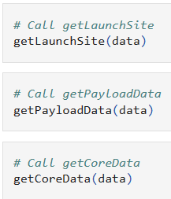
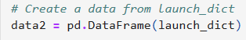
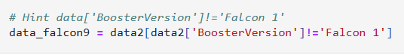
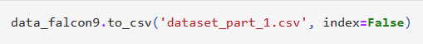
Data Collection – SpaceX API
1- Getting Response from API
2-Converting Response to Json
3- Transforming Data
4- Creating Data Dictionary
5- create/Filter Dataframe
6- Export dataset to CSV File
Code Source

Slide 9
Data Collection - Scraping
1- Getting Response from API
2- Creating BeautifulSoup Object
3- Find all Tables/Columns
4- Create Dictionary
5- Add Data to Keys
6- Create Dataframe
7- Export to CSV File
Code Source

Slide 10
Data Wrangling
Check the missing data ,and data types and do on of the following to clean the data :
Replace the missing data with one-Using mean or so.
Change data type of the data.
Represent categorical data using integer or float dummy numbers -one hot encoding
Transform string variables into categorical variables
1- Calculating Lunches for each Site
2- Calculating Number and Occurrence for each Orbit
3- Calculate Number and Occurrence of mission Outcome per Orbit Type
4- Creating Landing Outcome Label from Outcome Column
5- Export to CSV File

Slide 11
EDA with Data Visualization
Scatter Graphs
Flight Number vs. Payload Mass
Flight Number vs. Launch Site
Payload vs. Launch Site
Orbit vs. Flight Number
Payload vs. Orbit Type
Orbit vs. Payload Mass
Bar Graph
Success rate vs. Orbit
Line Graph
Success rate vs. Year
Matplotlib and Seaborn
Folium
Dash
Code Source

Slide 12
EDA with SQL
• The data is queried using SQL to answer several questions about the data such as:
• The names of the unique launch sites in the space mission
• The total payload mass carried by boosters launched by NASA (CRS)
The average payload mass carried by booster version F9 v1.1
List the date when the first successful landing outcome in ground pad was achieved.
List the names of the boosters which have success in drone ship and have payload mass greater than 4000 but less than 6000.
List the total number of successful and failure mission outcomes.
List the names of the booster_versions which have carried the maximum payload mass.
List the records which will display the month names, failure landing_outcomes in drone ship, booster versions, launch_site for the
months in year 2015.
Rank the count of successful landing_outcomes between the date 04-06-2010 and 20-03-2017 in descending order.
Code Source

Slide 13
Build an Interactive Map with Folium
Functions from the Folium libraries are used to visualize the data through interactive maps.
The Folium library is used to: Mark all launch sites on a map
Mark the succeeded launches and failed launches for each site on the map
Mark the distances between a launch site to its proximities such as the nearest city, railway, or highway
Code Source

Slide 14
Build a Dashboard with Plotly Dash
Functions from Dash are used to generate an interactive site where we can toggle the input using a dropdown menu and a range slider.
Using a pie chart and a scatterplot, the interactive site shows:
The total success launches from each launch site
The correlation between payload mass and mission outcome (success or failure) for each launch sit
Code Source

Slide 15
Predictive Analysis (Classification)
Functions from the Scikit-learn library are used to create our machine learning models.
• The machine learning prediction phase include the following steps:
• Standardizing the data
Splitting the data into training and test data
Creating machine learning models, which include:
Logistic regression
Support vector machine (SVM)
Decision tree
K nearest neighbors (KNN)
Fit the models on the training set
Find the best combination of hyperparameters for each model
Evaluate the models based on their accuracy scores and confusion matrix
Code Source

Slide 16
Results
The results are split into 5 sections:
SQL (EDA with SQL)
Matplotlib and Seaborn (EDA with Visualization)
Folium
Dash
Predictive Analysis
In all the graphs that follow, class 0 represents a failed launch outcome while class 1 represents a successful launch outcome

Slide 17

Section 2

Slide 18
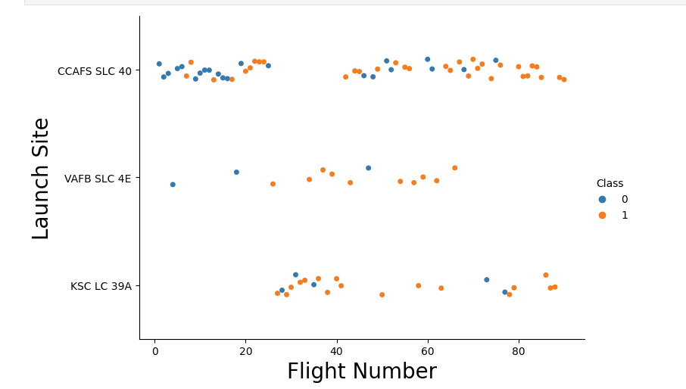
Flight Number vs. Launch Site
This plot shows an increase success rate for each site

Slide 19
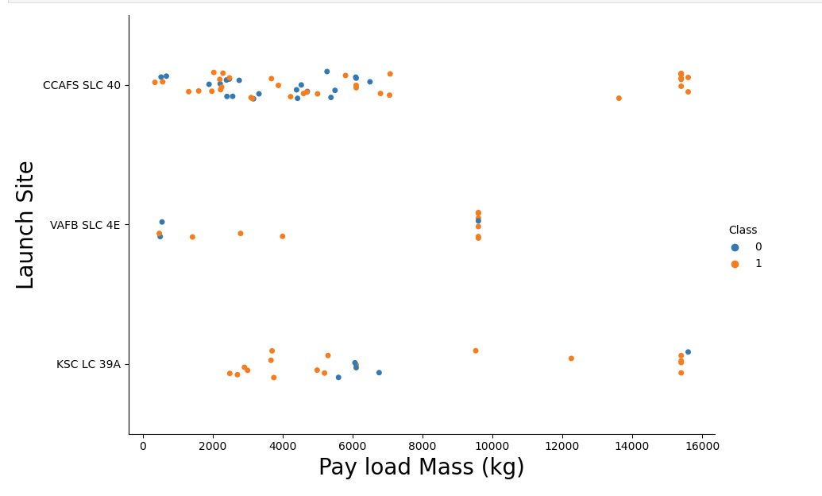
Payload vs. Launch Site
Payload is a contributing factor to successful landing. Heavy payload may mac a landing fail

Slide 20
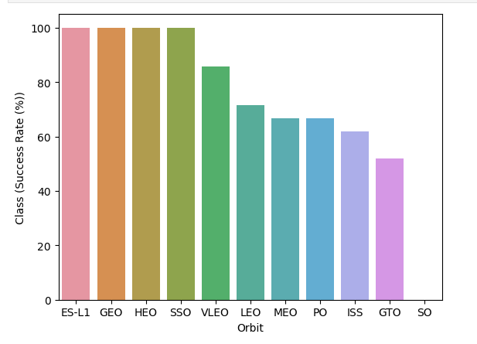
Success Rate vs. Orbit Type
This plot shows that Space X Rocket and success have a positive relationship. With increase in Space X, success rate increases.

Slide 21
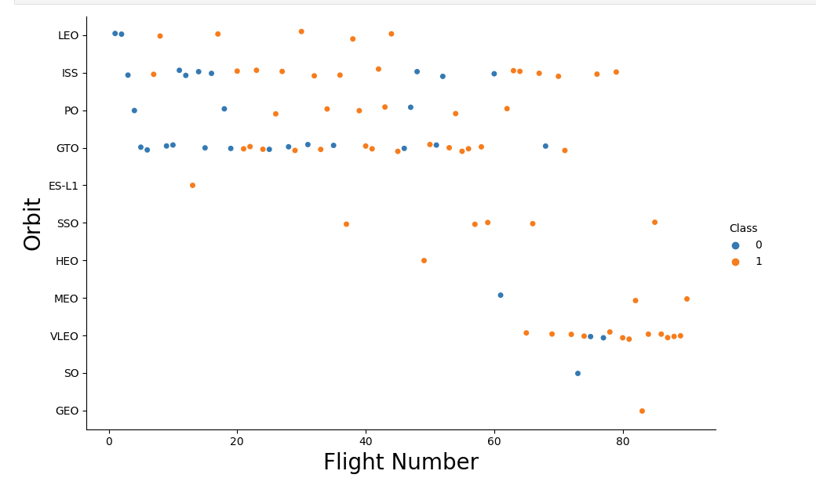
Flight Number vs. Orbit Type
This Scatter Plot shows that success rate increases with the number of flights for the LEO orbit

Slide 22
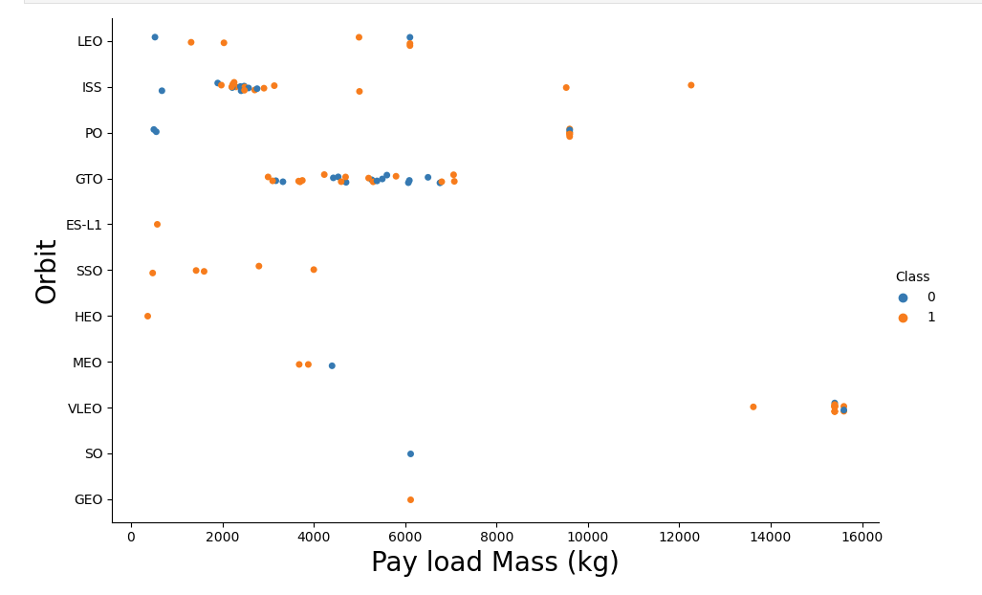
Payload vs. Orbit Type
The weight of the payloads can have a great influence on the success rate of the launches in certain orbits.
Heavier payloads improve the success rate for the LEO orbit.
Decreasing the payload weight for a GTO orbit improves the success of a launch

Slide 23
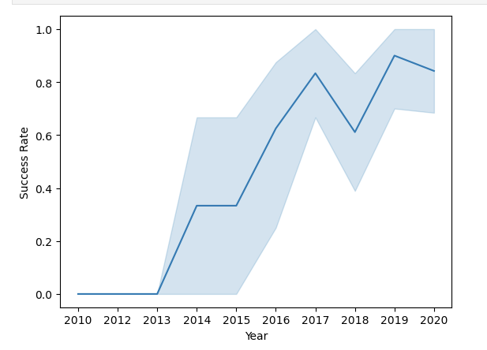
Launch Success Yearly Trend
Since 2013, we can see an increase in the Space X Rocket success rate.

Slide 24
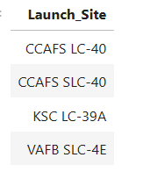
All Launch Site Names
sql SELECT DISTINCT LAUNCH_SITE FROM SPACEXTBL ORDER BY 1;
This query retrieves unique lunch sites

Slide 25
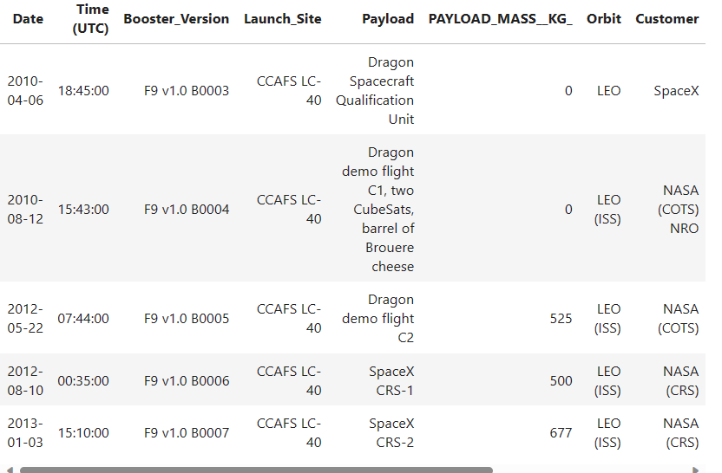
Launch Site Names Begin with 'CCA'
sql SELECT * FROM SPACEXTBL WHERE LAUNCH_SITE LIKE 'CCA%' LIMIT 5;
This query retrieves records with lunch site that match the ‘like’ expression and show only 5 records

Slide 26
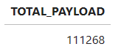
Total Payload Mass
sql SELECT SUM(PAYLOAD_MASS__KG_) AS TOTAL_PAYLOAD
FROM SPACEXTBL WHERE PAYLOAD LIKE '%CRS%';
This query display the total payload mass carried
by boosters launched by NASA (CRS)

Slide 27
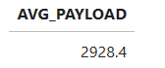
Average Payload Mass by F9 v1.1
sql SELECT AVG(PAYLOAD_MASS__KG_) AS AVG_PAYLOAD FROM SPACEXTBL WHERE BOOSTER_VERSION = 'F9 v1.1';
This query retrieve average payload mass carried by booster version F9 v1.1

Slide 28
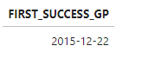
First Successful Ground Landing Date
sql SELECT MIN(DATE) AS FIRST_SUCCESS_GP FROM SPACEXTBL WHERE Landing_Outcome = 'Success (ground pad)';
This query lists the date when the first successful landing outcome in ground pad was achieved using Min function.

Slide 29
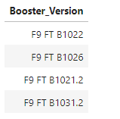
Successful Drone Ship Landing with Payload between 4000 and 6000
sql SELECT DISTINCT BOOSTER_VERSION FROM SPACEXTBL WHERE PAYLOAD_MASS__KG_ BETWEEN 4000 AND 6000 AND Landing_Outcome = 'Success (drone ship)';
This query returns the booster version where landing
was successful and payload mass is between 4000
and 6000 kg. The WHERE and AND clauses filter the
dataset

Slide 30
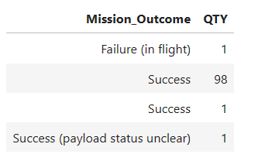
Total Number of Successful and Failure Mission Outcomes
sql SELECT MISSION_OUTCOME, COUNT(*) AS QTY FROM SPACEXTBL GROUP BY MISSION_OUTCOME ORDER BY MISSION_OUTCOME;
This query shows the count of success and failure missions by grouping data and counting records in each category

Slide 31
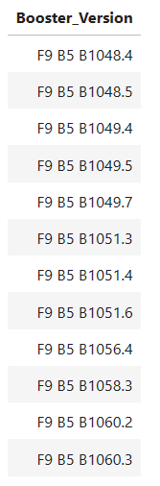
Boosters Carried Maximum Payload
sql SELECT DISTINCT BOOSTER_VERSION FROM SPACEXTBL WHERE PAYLOAD_MASS__KG_ = (SELECT MAX(PAYLOAD_MASS__KG_) FROM SPACEXTBL) ORDER BY BOOSTER_VERSION;
This query lists the names of the booster_versions which have carried the maximum payload mas using max function in subquery

Slide 32
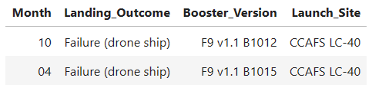
2015 Launch Records
sql SELECT substr(Date, 6, 2) as Month, Landing_Outcome, BOOSTER_VERSION, LAUNCH_SITE FROM SPACEXTBL WHERE Landing_Outcome = 'Failure (drone ship)' AND substr(Date,1,4) = '2015' ;
This query lists the records which will display the month names, failure landing_outcomes in drone ship ,booster versions, launch_site for the months in year 2015.

Slide 33
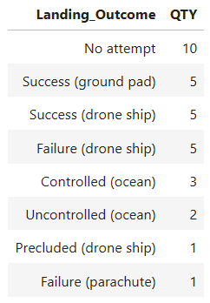
Rank Landing Outcomes Between 2010-06-04 and 2017-03-20
sql SELECT Landing_Outcome, COUNT(*) AS QTY FROM SPACEXTBL WHERE DATE BETWEEN '2010-06-04' AND '2017-03-20' GROUP BY Landing_Outcome ORDER BY QTY DESC;
This query ranks the count of landing outcomes (such as Failure (drone ship) or Success (ground pad)) between the date 2010-06-04 and 2017-03-20, in descending order

Slide 34

Section 3

Slide 35
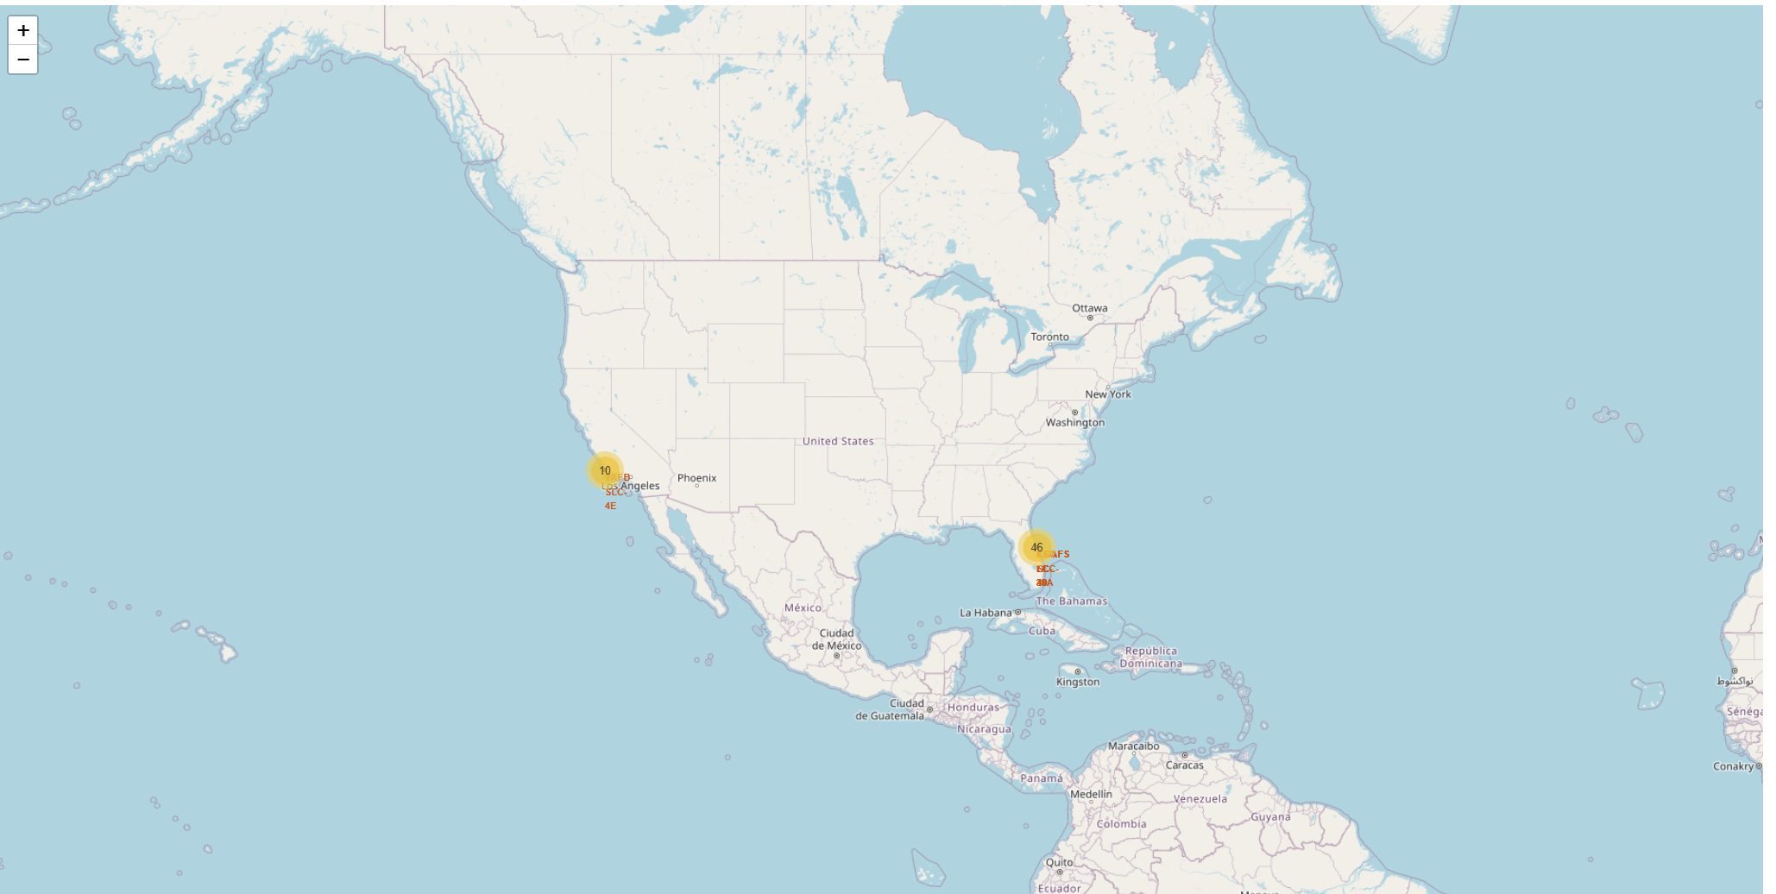
Folium map – Ground stations
We see that Space X launch sites are located on the coast of the United States

Slide 36
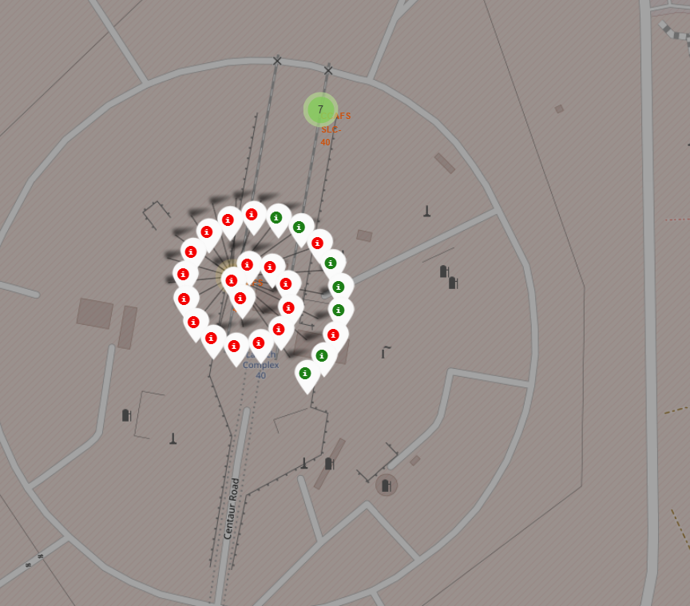
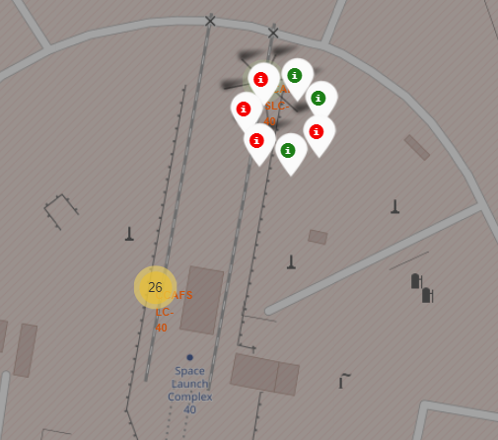
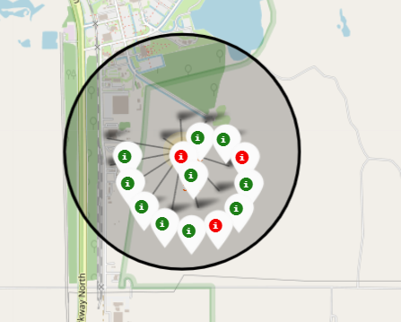
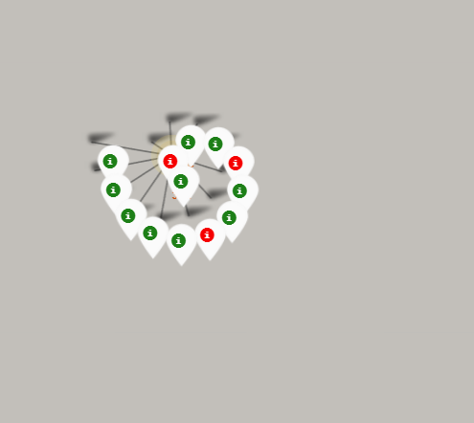
Folium map – Color Labeled Markers
Marker colors are based on class
Green -> successful lunches
Red -> unsuccessful lunches

Slide 37
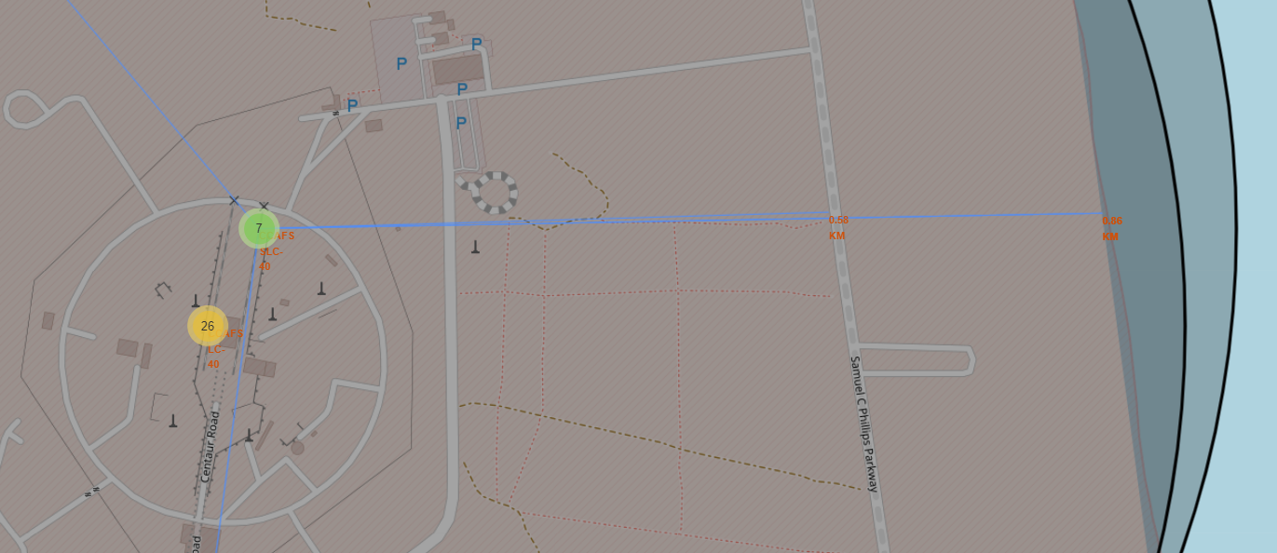
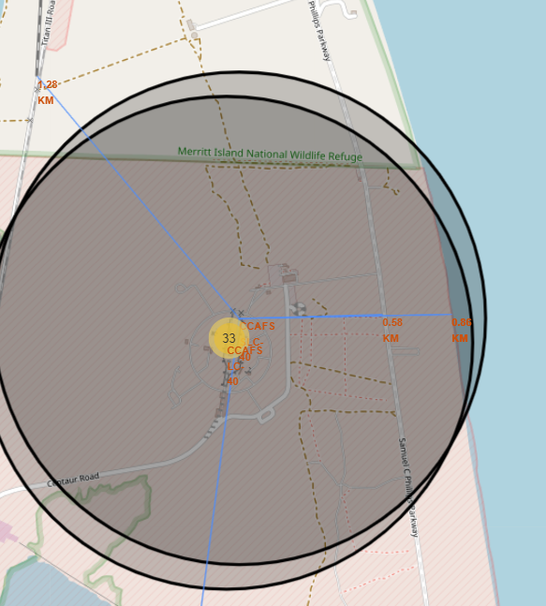
Folium Map – Distances between CCAFS SLC-40 and its proximities
Is CCAFS SLC-40 in close proximity to railways ? Yes
Is CCAFS SLC-40 in close proximity to highways ? Yes
Is CCAFS SLC-40 in close proximity to coastline ? Yes
Do CCAFS SLC-40 keeps certain distance away from cities ? No

Slide 38

Section 4

Slide 39
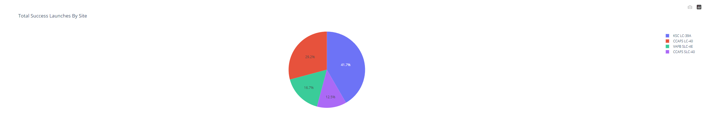
Dashboard – Total success by Site
We see that KSC LC-39A has the best success rate of launches.

Slide 40
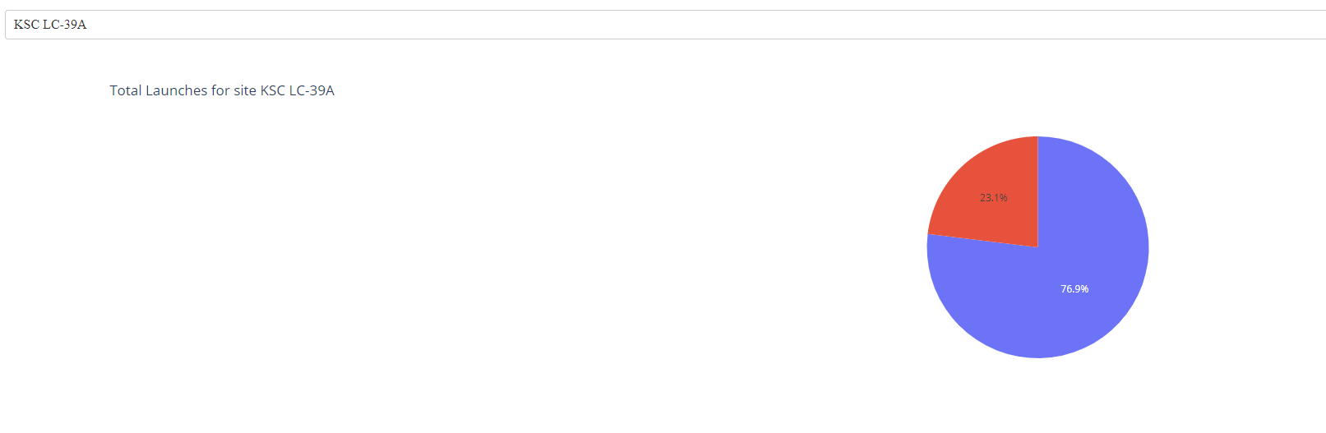
Dashboard – Total success launches for Site KSC LC-39A
We see that KSC LC-39A has achieved a 76.9% success rate while getting a 23.1% failure rate.

Slide 41
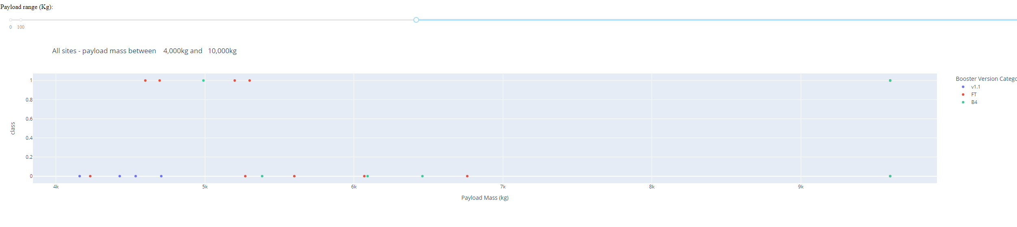
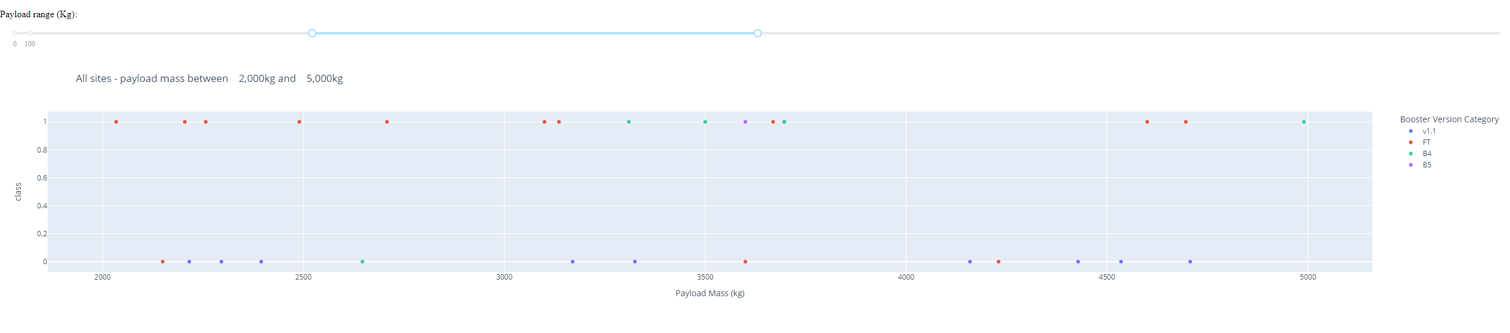
Dashboard – Payload mass vs Outcome for all sites with different payload mass selected
These plots show the impact of low weighted and heavy weighted payloads on success rate.

Slide 42

Section 5

Slide 43
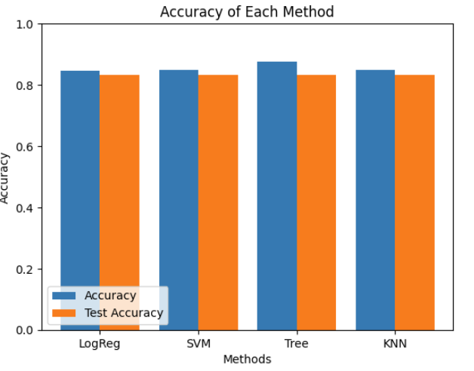
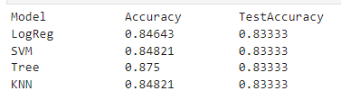
Classification Accuracy
For accuracy test, all methods performed similar. We could get more test data to decide between them. But if we really need to choose one right now, we will take the decision tree.

Slide 44

Confusion Matrix
Confusion matrix of the best performing model (Decision Tree)
This shows that positive values (TP/TN) are more than negative values (FP/FN). The only issue is that True Negative are way more than True Negative with a value of 12.

Slide 45
Conclusions
The success of a mission can be explained by several factors such as the launch site, the orbit and especially the number of previous launches. Indeed, we can assume that there has been a gain in knowledge between launches that allowed to go from a launch failure to a success
Several machine learning algorithms are employed to learn the patterns of past Falcon 9 launch data to produce predictive models that can be used to predict the outcome of a Falcon 9 launch.
For this dataset, we choose the Decision Tree Algorithm as the best model even if the test accuracy between all the models used is identical. We choose Decision Tree Algorithm because it has a better train accuracy

Slide 46


